Slide 1


Social Buzz
Analysis
Notes:
Good morning, everyone. Thanks for join us today. Let’s dive into the presentation of our data analysis project for Social Buzz company.

Slide 2


Today's agenda
Project recap
Problem
The Analytics team
Process
Insights
Summary
Notes:
Here’s the agenda for our presentation:

Slide 3

Social Buzz is a large growing social media platform where the users can react with the contents in various ways. To have a better understanding with the content performance and user experience, Accenture has been running a 3-month initial project and got following objectives:
An audit of the data practice
Recommendations for a successful IPO
Top 5 categories with the largest aggregated popularity
Project Recap

Slide 4

Problem
Expensive to maintain the high volume of data
500 Million active users each month that generate over 100,000 pieces of content
Lack of technical staff to work on the technology

Slide 5



Andrew Fleming
Chief Technical Architect
The Analytics team
Marcus Rompton
Senior Principle
Hanyu Chen
Data Analyst

Slide 6
Process
1
Data Understanding
2
Data Cleaning
3
Data Modeling
4
Data Analysis
5
Data Insight and Visualization

Slide 7

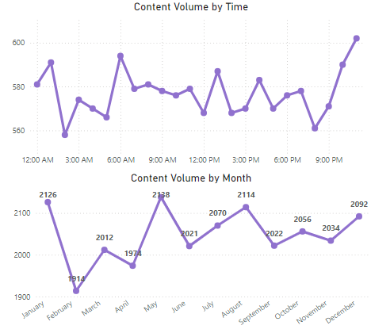
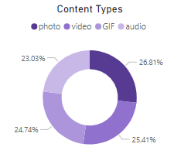
Insights
Contents have 16 categories (animals, cooking, etc.) with an average of 39.6 sentiment score, and 25K contents.
11PM-12AM and 6AM were the time that users highly engaged with contents
January and May were the months that has the most user engagements. （June should be excluded from the analysis)
Content types are evenly separated in photos, videos, GIFs, and audios.
Knowing user’s activities and preference can help Social Buzz to adjust and optimize the business strategies.

Slide 8
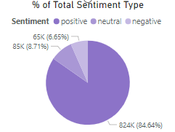
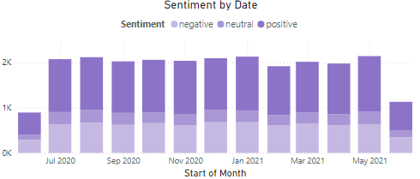
Insights
By looking at the % of total sentiment type, about 85% of the content reactions were positive and about only 9% were negative.
The month-to-month sentiment shows that the contents produced by users were not fluctuate a lot, and positive reactions were dominate among other types each month through out the year.
Social Buzz’s users are constantly engaged with the platform and most of the reactions towards the contents were positive.
* Data were not cover the entire month of June 2020 and June 2021.

Slide 9
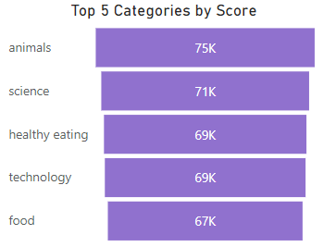
Insights
Among 16 Content Categories, Animals, Science, Healthy Eating, Technology, and Food are the top 5 most popular topics.
Knowing user’s preference in topic categories can help Social Buzz to generate more contexts in those 5 categories, which can retain user’s interests and attract more users.

Slide 10
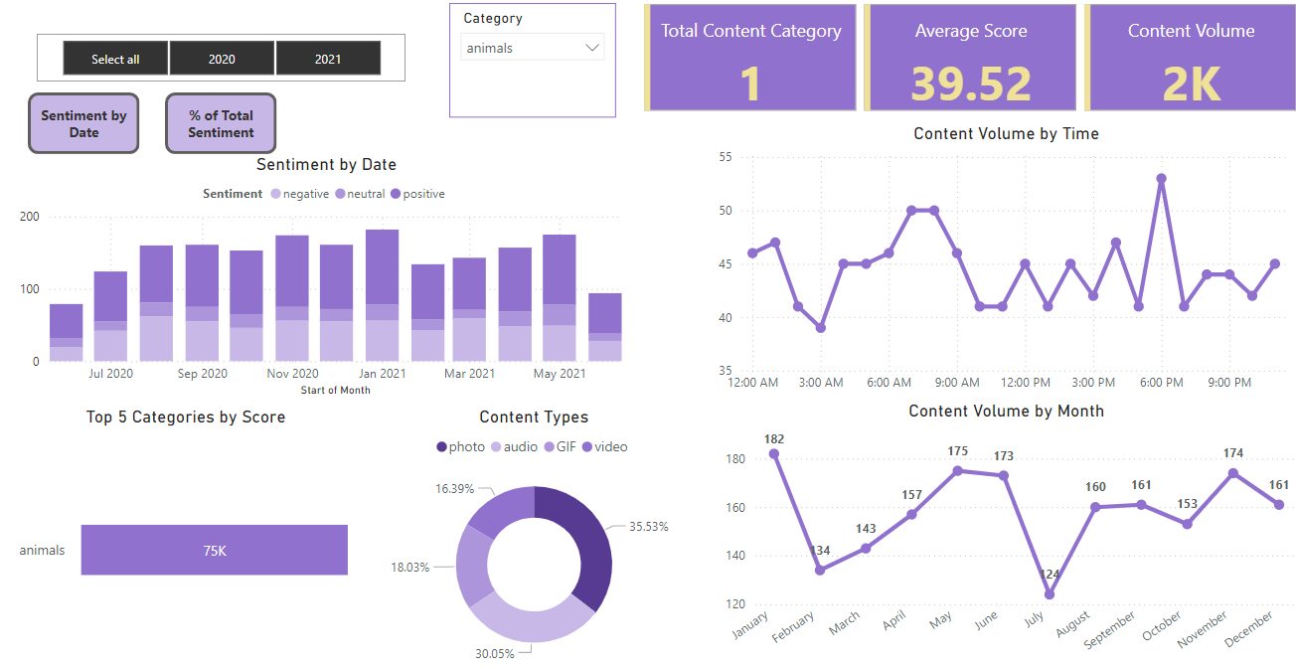
Insights
By digging into the top content category Animals, Social Buzz can tailor the contexts and adjust post date and time in the future based on monitoring user’s activities.

Slide 11


Social Buzz can monitor and adjust the strategy by looking through the user activities and content reactions
Social Buzz are steady growing in the industry and users are constantly engage with the platform and gave a high percentage of positive reactions, which can attract more potential shareholders to join.
Animals, science, healthy eating, technology, and food are the top 5 popular topics among current users. Focus improve those contexts have a high chance to retain the engagement of current users and attract more users.
Next Steps: This ad-hoc analysis is insightful, but it’s time to take this analysis into large scale production for real-time understanding of the business. We can show you how to do this.
Summary

Slide 12
Thank you!
ANY QUESTIONS?

